Slide 1
Welcome to our presentation
.

Slide 2
Classification of Computer
Presented By
Aarakshya Bhandari
Anup Lama Karki
Ashik Thapa
Bikal Thapa
Nikesh Magar

Slide 3
Classification of Computer
Computers Can be classified ,
On the basis of Size.
On the basis of Working Principle.
On the basis of Purpose.
On the basis of Brand.
On the basis of Model.

Slide 4
1. On the basis of size.
Classification of computer on the basis of size are:-
Super Computer.
Main Frame Computer.
Mini Computer.
Micro Computer.

Slide 5
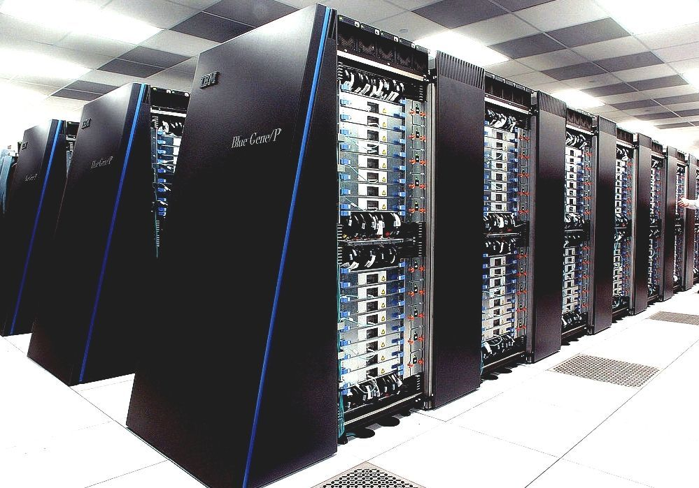
i) Super Computer
It is the fastest computer.
Use for weather
forecasting, biomedical
research, remote sensing, etc.
CRAY2, NEC SX-3,
CRAY XMP, Blue Gene,
Titan, etc. are super
computer.

Slide 6
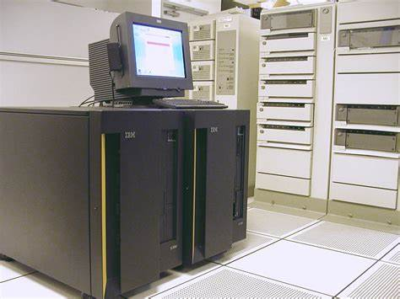
ii) Mainframe Computer
It is a Multi User Computer.
It have hundred or more than
thousand terminals.
DEC, ICL, IBM 370, IBM 3081
and T-Rex are Mainframe
Computer.

Slide 7
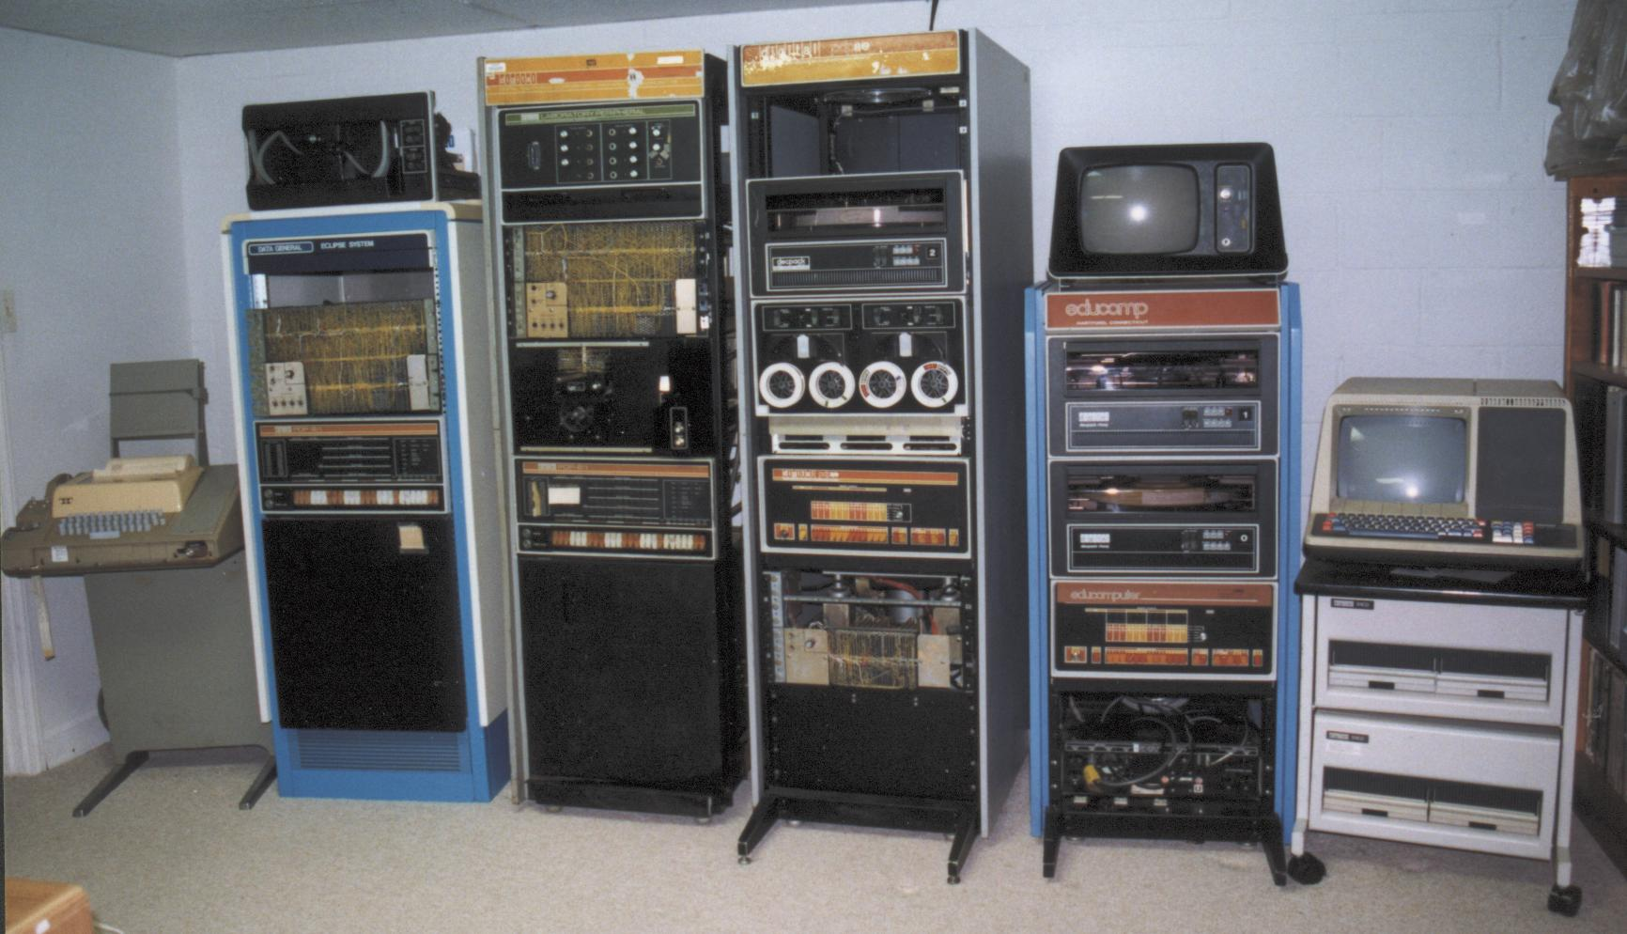
ii) Mini Computer
It is a Multi User Computer.
It have hundred or less
terminals.
PDP-8, HP 3000 series,
System/36,etc. are Mainframe
Computer.

Slide 8
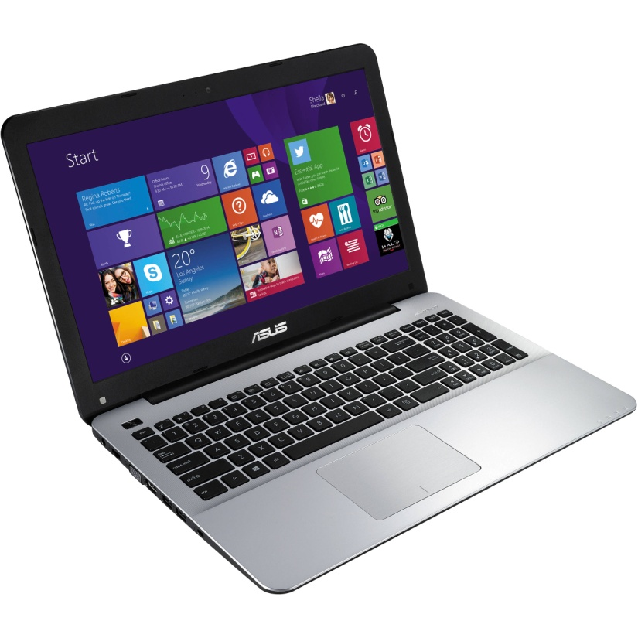
ii) Micro Computer.
It is a Single User Computer.
Desktop, Laptop, Palmtop
computer, etc. are Mainframe
Computer.

Slide 9
2. On the basis of working Principle.
Classification of computer on the basis of working principle are:-
Analog Computer.
Digital Computer.
Hybrid Computer.

Slide 10
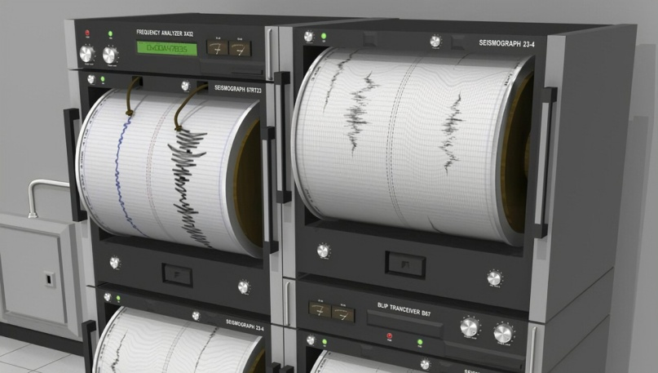
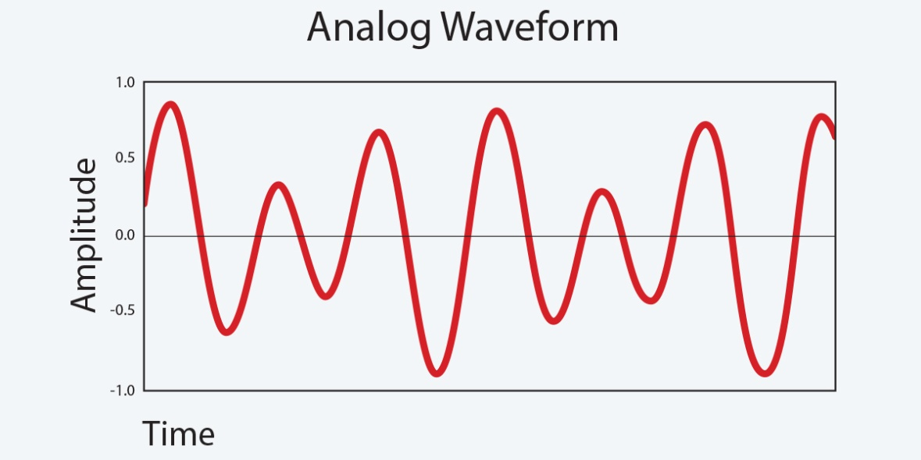
i)Analog Computer
It is the special purpose
computer.
Use for scientific and
engineering purpose, etc.
Speedometer, thermometer,
seismograph, etc. are Analog
computer.

Slide 11

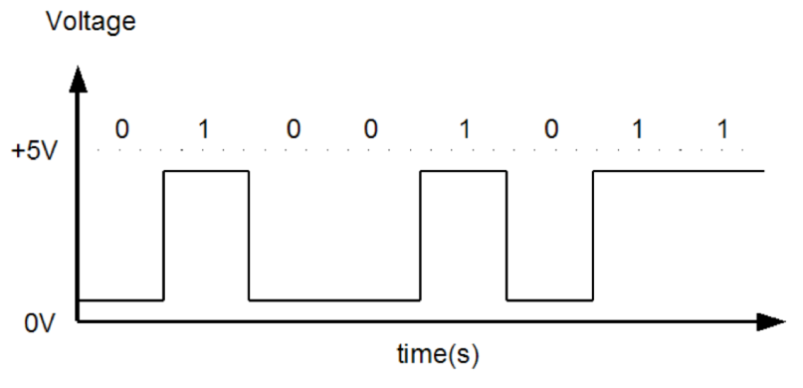
ii) Digital Computer
It is the general purpose
computer.
It uses discontinuous data.
Super, Mainframe, Mini, Micro
computers are Digital Computer.

Slide 12
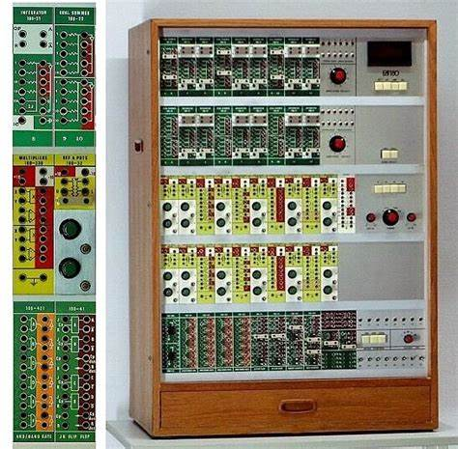
ii) Hybrid Computer
It is the special purpose
Computer.
Use in industrial application,
airplanes, ships, hospitals, etc.
ECG, ECHO, Holter Monitoring
machine, Ultrasound Machine,
etc. are Hybrid computer.

Slide 13
3. On the basis of purpose (use).
Classification of computer on the basis of use are:-
General purpose computer.
Special purpose computer.

Slide 14
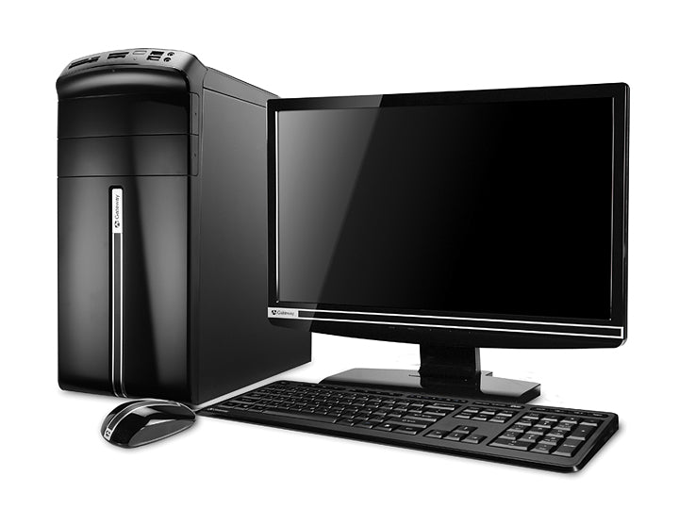
i) General purpose computer
It is versatile and diligent.
Desktop computer, laptop
computer, palmtop computer, etc.
are general purpose computer.
It can perform different tasks.

Slide 15
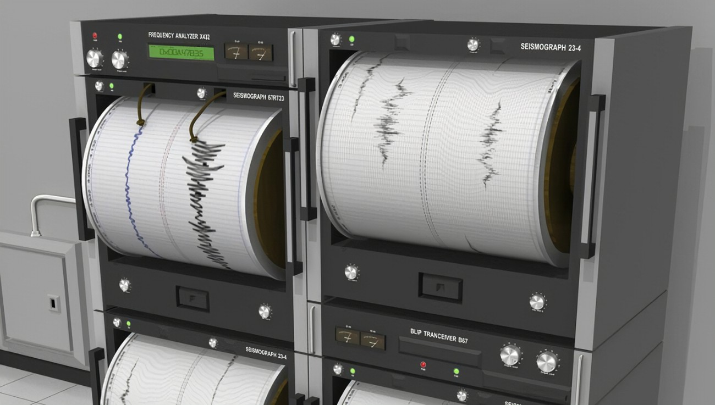
ii) Special purpose computer
It can perform only a specific
tasks.
Seismograph, traffic light
controlling computer, etc. are
special purpose computer.

Slide 16
4. On the basis of brand.
Classification of computer on the basis of brand are:-
IBM PC.
IBM Compatible PC.
Apple/ Macintosh.

Slide 17
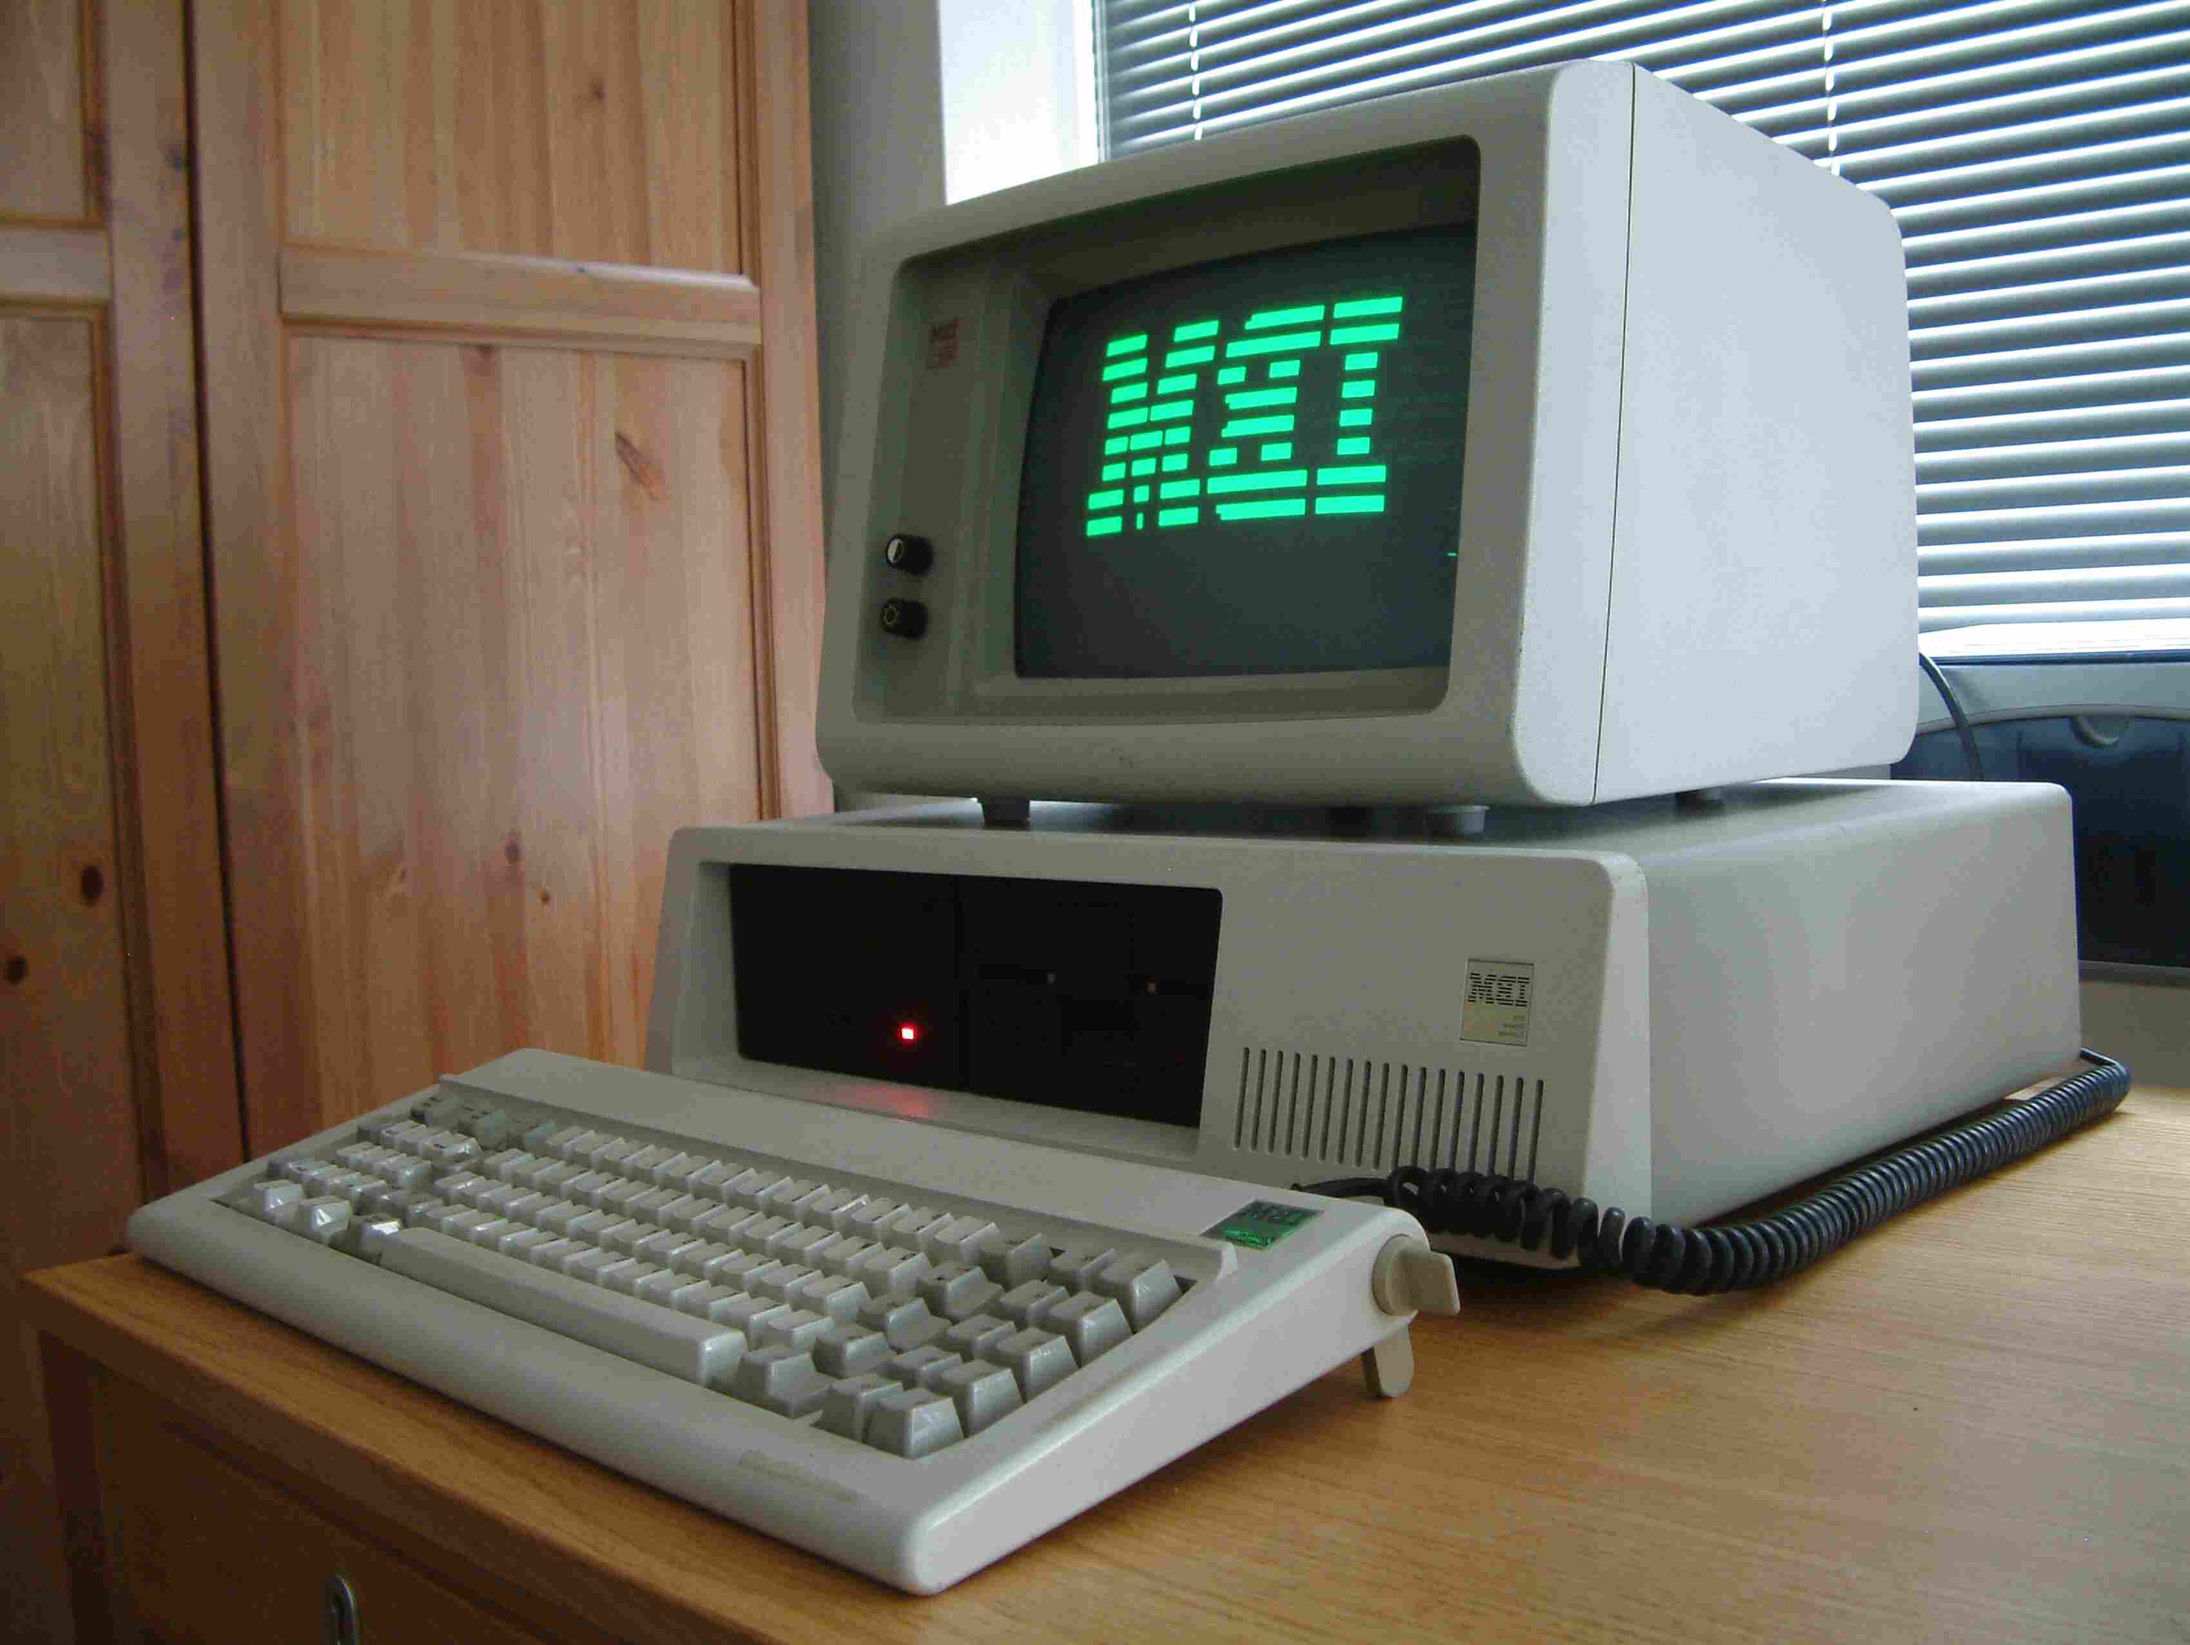
i) IBM PC
It is the brand name of the popular PC developed by IBM Corporation.
In 1981 the first IBM pc was launched.
It was equipped with an Intel 8088 processor.

Slide 18
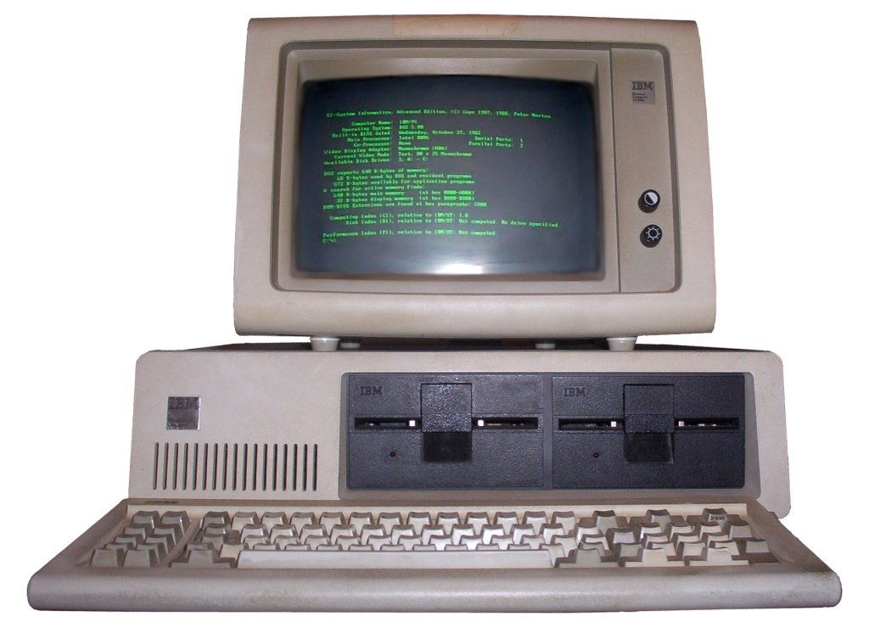
ii) IBM Compatible PC
It is generally called as assembled or duplicate PC.
It is Cheaper.
It is less reliable than IBM PC.

Slide 19
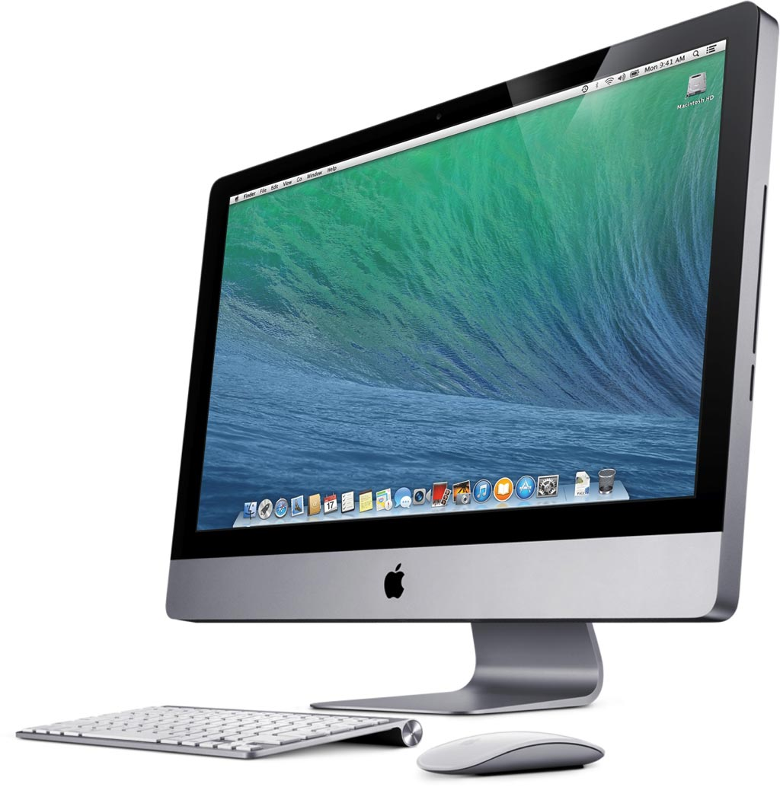
ii) Apple / Macintosh Computer.
It was developed by Apple Company.
It is personal Computer.
It is Expensive.

Slide 20
5. On the basis of model.
Classification of computer on the basis of model are:-
XT Computer.
AT Computer.
PS/2 Computer.

Slide 21
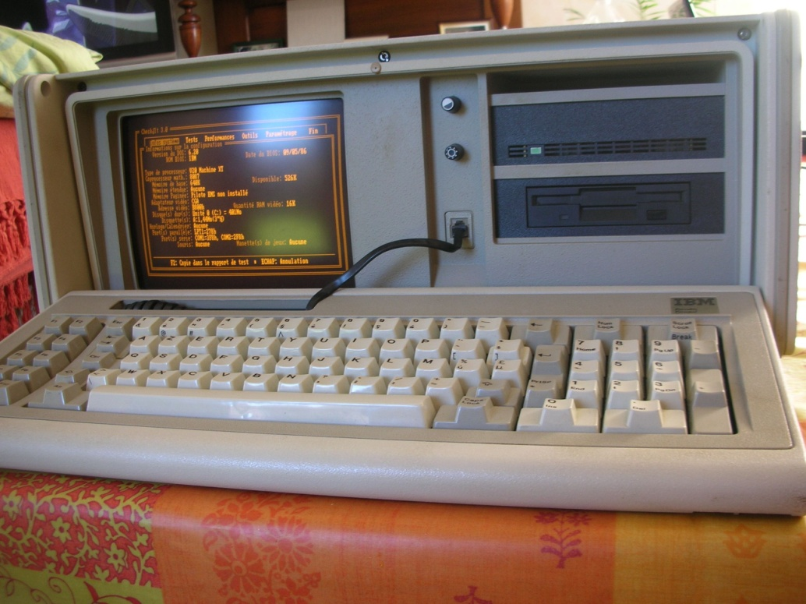
i) XT Computer.
It stands for extra or extended technology.
It have slow processing speed and no GUI.
It uses microprocessor like Intel 8080, 8086, 8088,etc.

Slide 22
i) AT Computer
It stands for Advanced technology.
It is faster in processing.
It can run both GUI and CUI.

Slide 23
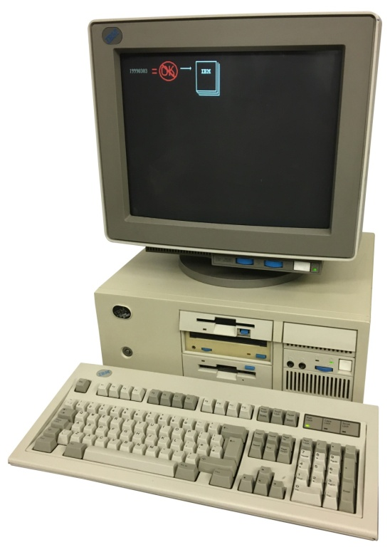
i) PS/2 Computer
It stands for Personal System.
It is the modification of AT.
It is Faster than AT.

Slide 24
Thanks For Supporting Us.
.

